Slide 1
Plant Disease Detection Using Hyperspectral Imaging
Explainable Edge-AI for Grapevine and Tomato Disease Diagnosis with Multilingual Advisory
Deep learning | Grad-CAM | Hyperspectral band analysis | Raspberry Pi 5

Slide 2
Project Overview
An intelligent plant-health analysis system that identifies plant diseases and examines subtle changes in leaf condition.
Predicts
Explains
Advises
Possible plant disease
Confidence score
Grapevine and tomato crops
Grad-CAM highlights affected leaf regions
Wavelength-specific band analysis
Spectral profile per ROI
Prevention, remedies and tips
English, Hindi and Marathi
Excel result export
PlantDiseaseAI
2

Slide 3
Problem and Motivation
Why diagnosis is hard
Limits of black-box CNNs
Early symptoms of different diseases look alike
Expert agronomists are scarce
RGB cameras average away narrow spectral changes
A label without justification
May be right for the wrong reason
Often needs cloud or GPU
Our answer
Show where on the leaf and in which wavelengths the evidence lies
Run offline on low-cost hardware
Speak the grower’s language
PlantDiseaseAI
3

Slide 4
Objectives
1
Classify grapevine (4 classes) and tomato (10 classes) leaf diseases
2
Explain each decision with Grad-CAM heatmaps
3
Reconstruct a 401-band spectrum (380–780 nm) from RGB
4
Provide a GUI with ROI selection, spectral graph and gain control
5
Deliver prevention, remedies and tips in three languages
6
Export results to Excel and run on a Raspberry Pi 5
PlantDiseaseAI
4

Slide 5
System Architecture
Input
Pi Camera / image file
Preprocess
Resize, normalise
Prediction
EfficientNet-B0
Explain
Grad-CAM overlay
Spectral
RGB → 401 bands
Output
Advice, Excel
›
›
›
›
›
Desktop and edge GUI
Edge hardware
PyQt6 with dual image viewports
Rubber-band ROI, live spectral graph
Raspberry Pi 5, Camera Module 3
5000 K LED ring chamber, 7-inch touch panel
PlantDiseaseAI
5

Slide 6
Dataset and Preprocessing
4,062
18,160
70:15:15
≤ 5
Grapevine images, 4 classes
Tomato images, 10 classes
Train / val / test, seed 42
pHash Hamming distance
Source and splits
Pipeline
PlantVillage colour subset
Grape: 2,843 / 609 / 610
Tomato: 12,712 / 2,724 / 2,724
Stratified random sampling
Resize: 224×224 grape, 256×256 tomato
ImageNet normalisation
Flip, rotation, shear, scale, colour jitter
Class-weighted loss for imbalance
PlantDiseaseAI
6

Slide 7
Deep Learning Model and Training
EfficientNet-B0
Training setup
Pretrained transfer learning, about 4.0 M parameters
MBConv blocks with squeeze-and-excitation, SiLU
Heads: 4 outputs (grape), 10 outputs (tomato)
Runs on CPU, GPU and Raspberry Pi 5
AdamW, weight decay 1e-4
Cosine annealing: 1e-3 down to 1e-5
Batch 32, up to 50 epochs, mixed precision
Gradient clipping at 1.0
Early stopping: grape at epoch 15, tomato at epoch 38
Validation accuracy 100% at stop
PlantDiseaseAI
7

Slide 8
Explainable AI: Grad-CAM
How it works
Human in the loop
Hooks on features[-1][0], the final 1280-channel layer
Gradient-weighted channel importance, then ReLU
Jet colormap blended at α = 0.45
Lesion-focused map: accept the result
Background-focused (fingers, glare, bench): re-image
Spectrum gives an independent cross-check
The overlay shows the network’s attention on a leaf, so a user can reject a result that looks right for the wrong reason.
PlantDiseaseAI
8

Slide 9
Hyperspectral Reconstruction from RGB
SpectrumTransfer
Reflectance | Healthy | Infected
550 nm (green peak) | 24.8% | lowered
670 nm (chlorophyll dip) | 8.2% | 27.4%
750 nm (NIR shoulder) | 53.4% | 24.1%
Colour features [R, G, B, R², G², B²]
6 PCA components, 401 bands, 380–780 nm
Calibrated with CIE colour matching and D65
Infected tissue: red reflectance rises and the near-infrared plateau collapses. The spectrum is a statistical estimate from RGB, not a measurement.
PlantDiseaseAI
9

Slide 10
Narrow Band Analysis Feature
Wavelength-specific analysis: examines individual narrow spectral bands to observe variations at specific wavelengths.
Detection of subtle changes: visualises minor variations that are hard to distinguish in normal images.
Spectral data analysis: extracts wavelength-specific information to compare leaf regions.
Plant health assessment: adds visual and spectral information to support investigation of disease-related changes.
Enhanced interpretation: complements deep-learning prediction and Grad-CAM with another perspective.
Bands in the app
Band 1: 400–450 nm
Band 2: 500–550 nm
Band 3: 600–650 nm
Band 4: 700–750 nm
All bands: 400–750 nm
Gain control 1.0x to 8.0x
Key benefit: a more detailed view of leaf characteristics by examining wavelength-specific information beyond the three colour channels of a standard RGB image.
PlantDiseaseAI
10

Slide 11
Results and Benchmarks
99.18%
98.42%
99.13%
98.28%
Grape accuracy, N = 610
Tomato accuracy, N = 2,724
Grape macro-F1
Tomato macro-F1
Platform (batch 1) | Inference + Grad-CAM | FPS | Peak memory
Desktop CUDA GPU | 11.4 + 4.2 = 15.6 ms | 64.1 | 1.12 GB VRAM
Desktop CPU (Intel i7) | 42.6 + 15.8 = 58.4 ms | 17.1 | 435 MB RAM
Raspberry Pi 5 | 124.8 + 36.5 = 161.3 ms | 6.2 | 365 MB RAM
PlantDiseaseAI
11

Slide 12
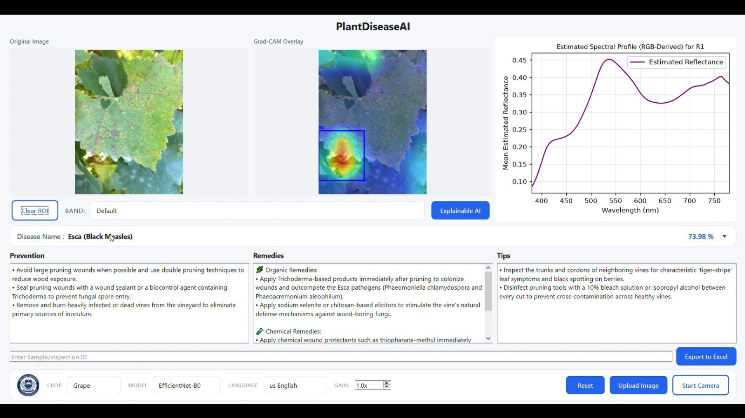
Application: Disease Prediction with Grad-CAM
On screen
Original image and Grad-CAM overlay
ROI box with spectral profile
Disease name and confidence
Prevention, remedies, tips
Gain control and Excel export
PlantDiseaseAI
12

Slide 13
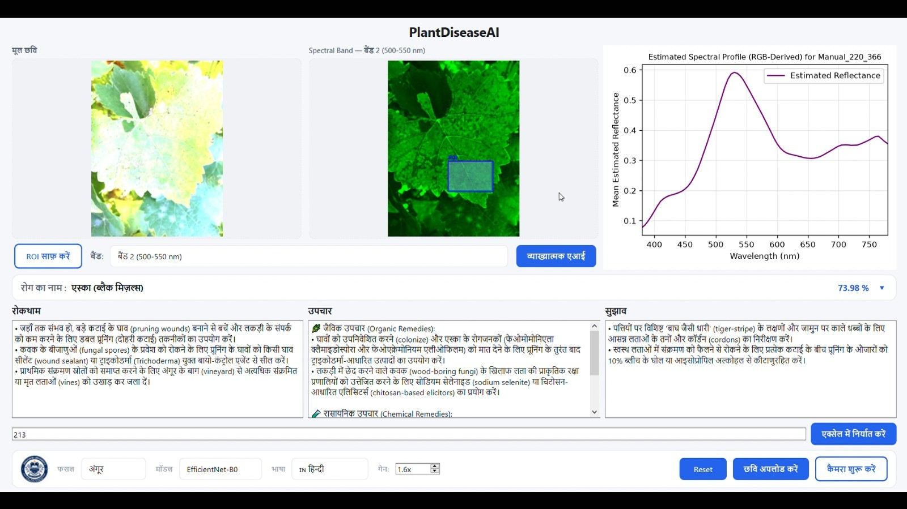
Multilingual Support: Hindi Interface
Language switch
English, Hindi, Marathi
Disease names and remedies in the chosen language
Narrow-band view (Band 2, 500–550 nm) beside the original
PlantDiseaseAI
13

Slide 14
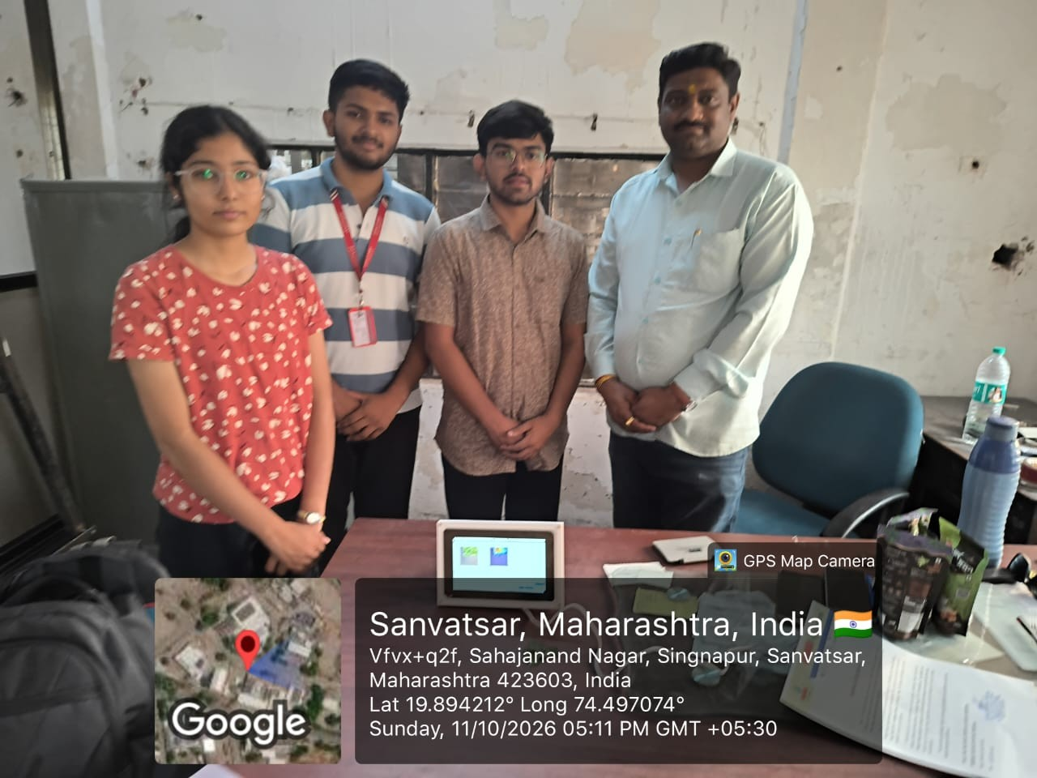
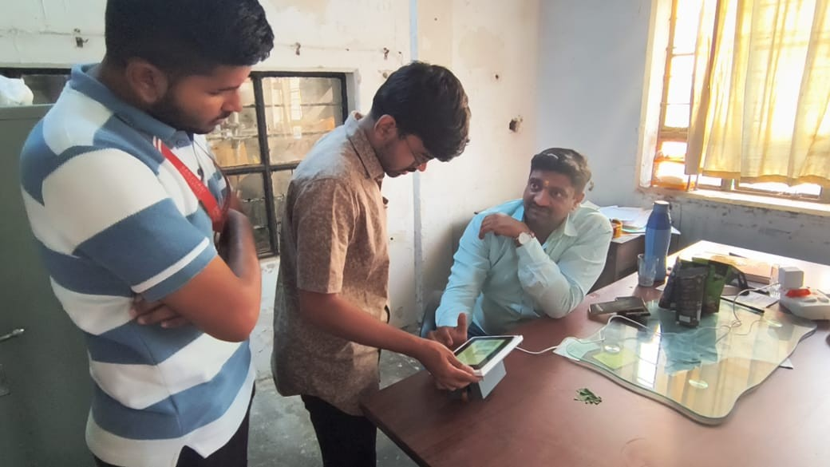
Prototype and Field Demonstration
Prototype on a 7-inch touch display, shown during a live demonstration.
PlantDiseaseAI
14

Slide 15
Advisory and Excel Export
Trilingual advisory
Excel workbook (3 sheets)
ICAR and MPKV terminology
Organic: Bordeaux mixture 1%, Trichoderma viride, NSKE 5%
Chemical: Mancozeb, Difenoconazole, Copper Oxychloride, Metalaxyl
Prevention and management tips
Spectral Intensity Data: wavelength 380–780 nm per ROI
Analysis Summary: disease, confidence, ROI area, reflectance, date
Graph: embedded spectral curve image
PlantDiseaseAI
15

Slide 16
Conclusion and Future Scope
Conclusion
Future scope
Accurate: 99.18% grape, 98.42% tomato
Explainable: Grad-CAM plus spectral view
Offline: 6.2 FPS on Raspberry Pi 5
Accessible: three languages, Excel records
UAV multispectral imaging
INT8 quantisation and NPU acceleration
Mobile field deployment
Field-image training and spectrometer validation
PlantDiseaseAI
16

